Slide 1
Writing about ecology
Área Académica: Ingeniería Mecánica
Profesor: L.E.L.I Leticia Sánchez Franco
Periodo: Julio-Diciembre 2016

Slide 2

Resumen
La redacción de ideas es de vital importancia en el desarrollo de la expresión escrita y un tema actual y de la vida cotidiana como lo es la ecología nos puede facilitar este proceso creativo.
Abstract
Writing ideas is an important task to develop the written expression skill. Then, an everyday life issue such as ecology, can help this creative process.
Key words: pollution, contamination, waste, chemicals, etc.

Slide 3
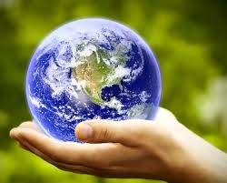
Before you start writing. Reflect on these questions.
What’s your city like?
Is your city contaminated? Why?
How is the community helping to reduce the pollution?

Slide 4
Answer the questions and separate them in different paragraphs
I live in Tula, Hidalgo. It is in the southwest of the state with a population of 103 919. It is an industrial but contaminated city. There are some factories and some parks. It is a tourist city. People visit the archeological site «Los atlantes de Tula». Tula has an important oil industry «Refinería Miguel Hidalgo» and the river «Tula».
The city is contaminated. The oil industry produces a lot of waste and toxic fumes. The river «Tula» is not clean . Waste and chemicals contaminate the river and people are suffering health problems.
Some people are helping our city. They plant trees or plants in their gardens. They recycle glass and paper. But many people do not take care for the city and planet. The streets are dirty. People drop trash.

Slide 5
REFERENCE:
Davis, P., Hernández M., Hernandez, C., Lopez, L., & Zavala J. (2014)
Make it real Professional. Universidad Autónoma del Estado de Hidalgo.

